Slide 1

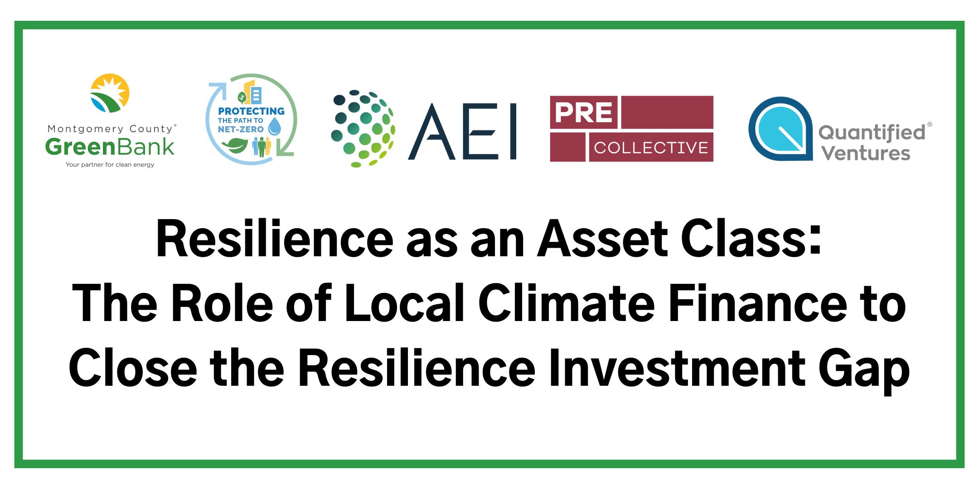
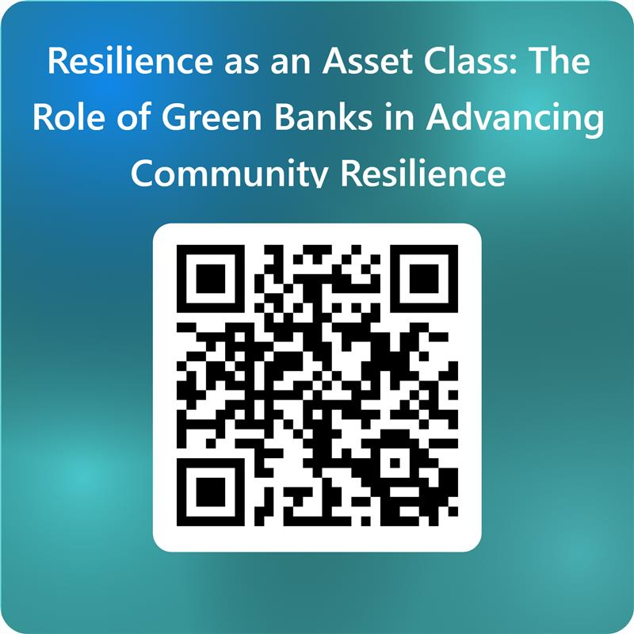
Welcome!
Please, help yourself to some breakfast and connect with other attendees.
Live Stream at: https://us02web.zoom.us/j/81859760738

Slide 2
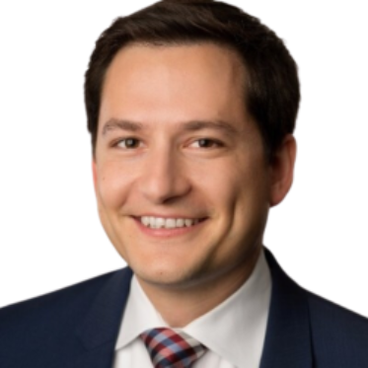

Opening Remarks
Stephen Morel is the Chief Executive Officer, formerly the Chief Investment Officer of the Montgomery County Green Bank. His professional background in corporate and project finance is critical to the Bank’s use of public and private funds to fill market gaps and catalyze investment into high impact sectors. Stephen has accelerated the deployment of programs and products towards achieving the Bank’s clean energy and energy efficiency objectives.
Prior to the MCGB, Stephen led a financial consulting company dedicated to connecting infrastructure developers with debt and equity financing sources. Stephen began his financial career in investment banking at Taylor-DeJongh and Friedman, Billings, Ramsey.

Slide 3
MCGB and Resilience
Protecting the Path to Net Zero (“PPNZ”)
Building resilience via: Education and Community Engagement Technical Assistance Innovative Financing | Action fronts via: Anticipate, plan, avoid Absorb, recover, minimize loss Learn, transform, reorganize
Coordinated tracks via: Physical resilience Energy resilience | Programmatic Frameworks via: Farmer-centered resilience finance Municipal resilience financing Residential resilience loans Dedicated Fund for affordable housing
Visit us at www.mcgreenbank.org.

Slide 4
Moving from Ambition to Action
Financing resilience is cheaper than financing recovery
Measure to manage, then finance to implement.
Bundle the urgent with the proactive.
Design for value, not just compliance.
Unlock risk-adjusted returns with strategic investments.
Community scale impact, sustained private capital.
Replication and scale with green banks.

Slide 5
Event Agenda
Event Agenda
8:30am | Breakfast and Networking
9:00am | Opening Remarks and Event Objectives
9:10am | Panel Discussions Protecting the Path to Net Zero and the Resilience Dedicated Fund Investor and Partner Perspectives Technical Assistance Magic Investor and Borrower Discovery Q&A
10:35am | BREAK
10:45am | Breakout Discussions on Saling and Replication Investors and Philanthropy Property Owners and Developers Technical Assistance Providers and Contractors
11:30am | Report-Out and Next Steps
12:00am | Closing Remarks and Additional Networking

Slide 6
Protecting the Path to Net Zero and the Resilience Dedicated Fund

Slide 7
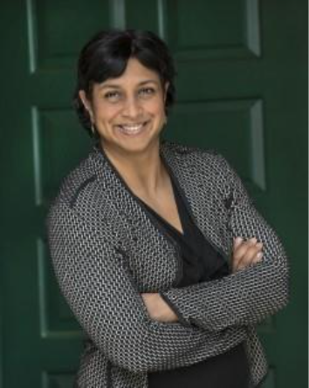

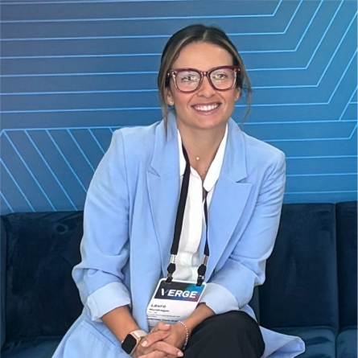

Shalini Vajjhala is the Executive Director of PRE Collective and a nationally recognized infrastructure and climate resilience expert with more than 20 years of experience designing, funding, and financing community-centered resilient infrastructure solutions. Over the last decade, she founded and led the design firm re:focus partners, and previously, she held multiple positions in the Obama Administration at the US EPA and the White House Council on Environmental Quality.
Shalini holds a B.Arch in Architecture and Ph.D. in Engineering and Public Policy from Carnegie Mellon University.
Laura Mondragon is the Sr. Director of Climate Resilience and Adaptation at the Montgomery County Green Bank. She leads the Bank’s flagship resilience financing program, Protecting the Path to Net-Zero (PPNZ), a pioneering initiative shifting climate resilience financing from reactive, grant-dependent models to proactive, investment-driven approaches. ​
​
Laura has career experience working at the international level with financial institutions across Latin America, supporting their transition toward net-zero business models. She managed a climate risk management technical assistance program, contributed to the design of regional green bond initiatives, and collaborated with global climate funds and donors. Originally from Colombia, Laura has lived in Montgomery County for many years with her husband and four children.

Slide 8
Resilience Dedicated Fund: Mechanism of Innovation
Marries line of credit flexibility with impact fund discipline
Low-interest revolving loan
Financing tied to qualifying resilience interventions
Embedded technical support (ASTM PRA, Product Support Program)
Positions resilience as a bankable asset class
Designed for Hyperlocal Scale: Affordable housing in Montgomery County
Deploy catalytic capital quickly
Build replicable model of adaptation finance
Capital Sources (Public + Private + Philanthropy)

Slide 9

Structure Breakdown of the Dedicated Fund
Loan Amounts: $3M to 5M
Rate: 2.5 to 9% fixed, with lower rates for highest-impact projects; monthly interest-only payments.
Term: 3 years, extendable
Collateral: Assessed by borrower
Repayment: Revolving → multiplies impact

Slide 10

Resilience Dedicated Fund: Product Support Program
Access to a sophisticated expert network to support and guide identification of multi-benefit investments in building sustainability.

Slide 11


Use of Proceeds
Borrowers can use up to 50% for capital improvements.
Every capital improvement investment needs to be paired with a resilience investment.
There’s no cap on the use of the facility for resilience investments
Borrowers can use up to 30% in resilience related studies and consultancy fees
Borrower must contribute 10% equity for every investment
Capital Improvements (includes clean energy) | Resilience Investments | Resilience Related Studies
Roof Leak | Green Roof Installation | Property Resilience Assessment
Solar | Structural hardening for extreme weather | Assessment for indoor air quality upgrades

Slide 12


Key Performance Metrics
Standardize impact & repayment metrics
1
Isolate repayment drivers
2
Project‑ and property‑level data collection & tracking
3

Slide 13

Projected 3=Year Outcomes
20+ properties upgraded with resilience measures
3,000+ residents with reduced climate‑risk exposure
20% average utility‑cost reduction
Financial value creation
  -Avoided maintenance & operational savings
  -Reduced recovery costs; lower insurance premiums
  -Increased asset value
Replication toolkit for green banks & CDFIs

Slide 14
Investor and Partner Perspectives

Slide 15
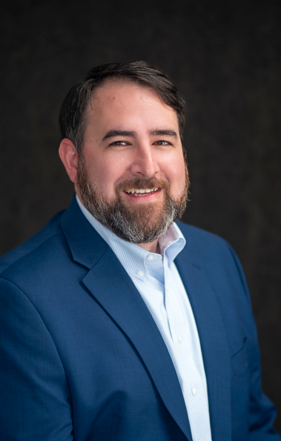



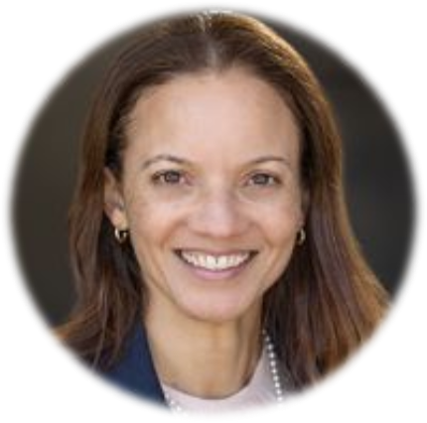

Lex Ford is the CEO and President of Climate First Bank, the world’s first FDIC-insured bank founded to combat the climate crisis. The bank has $1.3 billion in assets with a total capitalization of more than $120 million, the fast-growing bank in the nation.
Climate First Bank opened in 2021 with an initial capitalization of $44 million. Later in 2022, the bank completed the move to a holding company structure with a second subsidiary, OneEthos, Inc., a fin-tech developing technology on behalf of Climate First Bank. Since opening, OneEthos has completed the acquisition of two technology companies, eCountabl and Tool Charm, while powering Climate First Bank to originating over 4,000 consumer solar loans for over $190 million through a nationwide digital channel.
Ali Khademian is the Sustainability Program Manager at the Montgomery Housing Partnership, a leading nonprofit affordable housing developer. Ali oversees the efforts to implement energy savings and sustainability measures and serves on Montgomery County's Climate, Energy, and Air Quality Advisory Committee. ​ ​ Ali began his career in affordable housing in 2017 at the Housing Opportunities Commission of Montgomery County within the Office of Legislative and Public Affairs, Property Management, and the Housing Resources Division. He earned his bachelor's degree in Government and Politics from the University of Maryland - College Park, and his Juris Doctor from Cooley Law School where he was class valedictorian. ​
Leila Finucane is the Chief Executive Officer and President of Victory Housing, Inc, the nonprofit affiliate of the Catholic Archdiocese of Washington focused on providing affordable housing and assisted living for seniors in Maryland and Washington, DC. Leila, an attorney, has over 25 years of experience in real estate, affordable housing, and community development. Leila has experience at Capital One, NeighborWorks America, National Initiatives and Applied Research Division, and Department of Housing and Community Development for the District of Columbia. ​
​
Leila holds a Bachelor of Arts in American History and African-American Studies from the University of Pennsylvania and Master of Urban Planning and Juris Doctor degrees from New York University. ​

Slide 16
Technical Assistance Magic

Slide 17
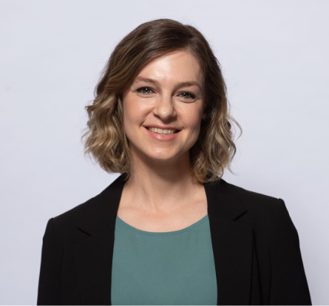

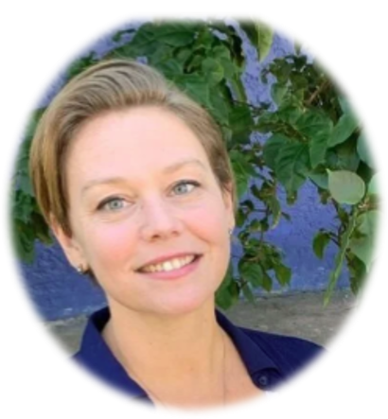

Helena Ariza currently leads the Sustainability & Resilience Division of AEI Consultants, overseeing ESG services and Property Resilience Assessments for multi-family and commercial properties. She is an architect from Barcelona, licensed as a Registered Architect (RA) in the State of New York as well as her native Spain. Early in her career she focused on promoting sustainable practices and tackling climate risk.
With a background in façade design, energy code compliance, and a postgraduate degree in Architectural Restoration she combines her diverse experience to develop innovative approaches to fulfill the industry needs and requirements in a fast-evolving environment.
Tee Thomas is the CEO of Quantified Ventures and has 15+ years of water financing and environmental equity experience. Prior to QV, she served as the Water Finance Director for the state of Vermont, wrote and helped pass Act 185 which overhauled the Vermont’s Clean Water State Revolving Fund, created the Natural Infrastructure Interim Financing Program, served at the Iowa Department of Natural Resources’ Drinking Water Program and later with the Iowa Department of Transportation as the National Environmental Policy Act Manager. ​ ​ Tee has an MPH from Des Moines University and a BS, Iowa Wesleyan University. ​

Slide 18

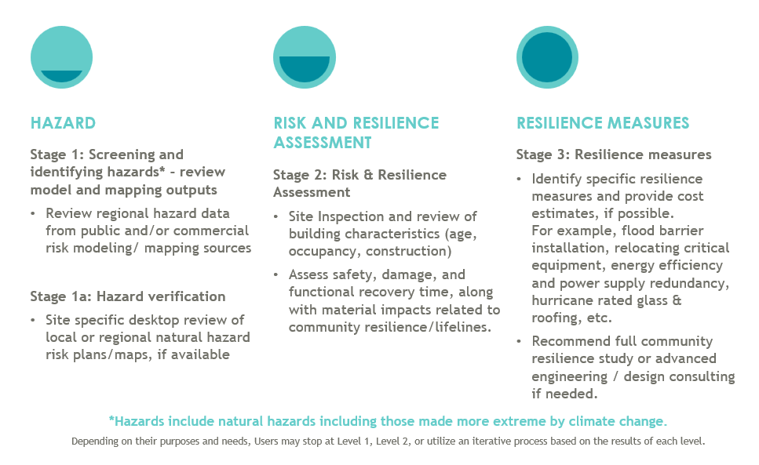
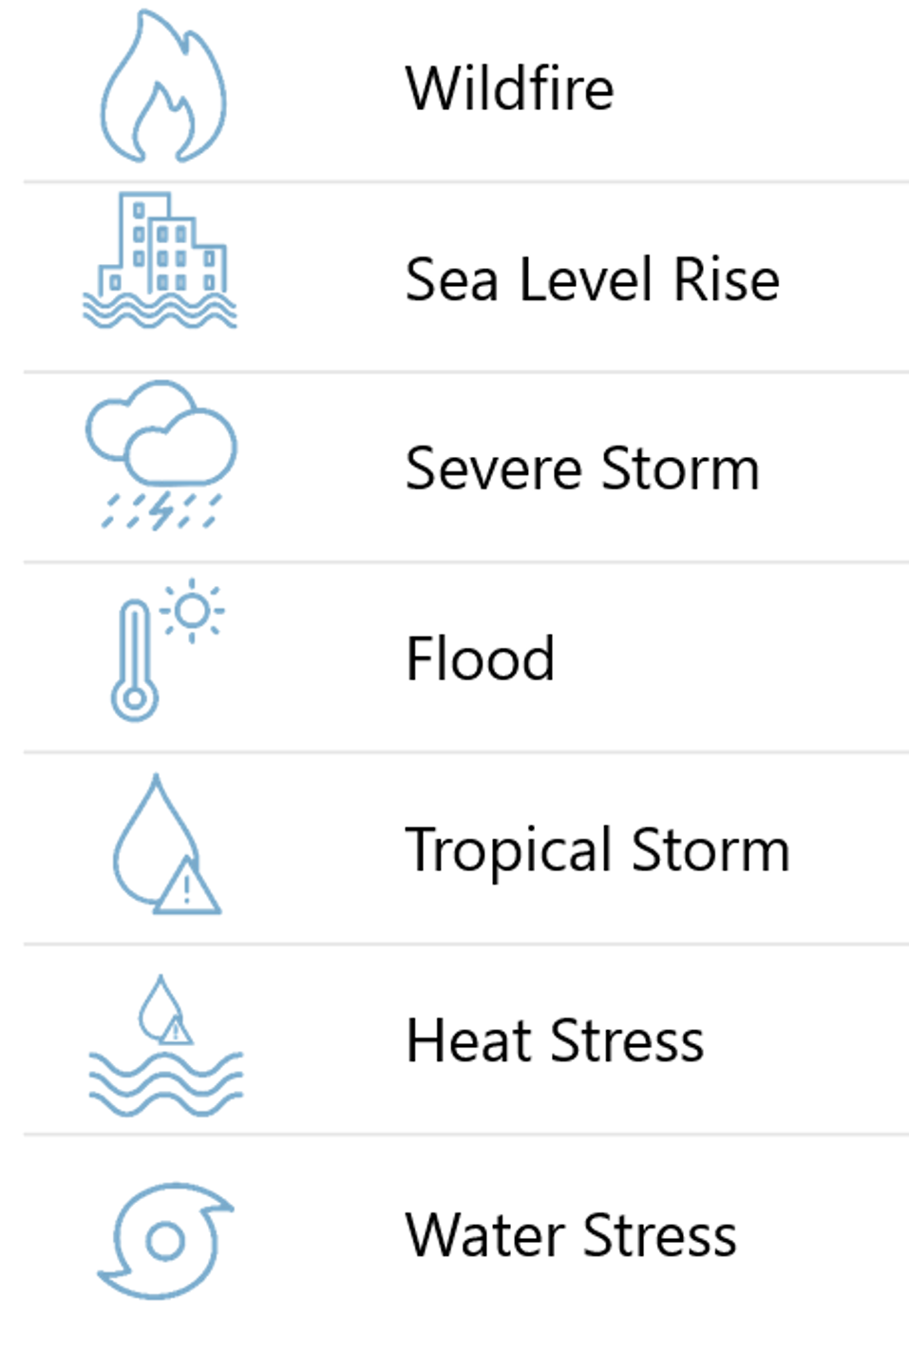
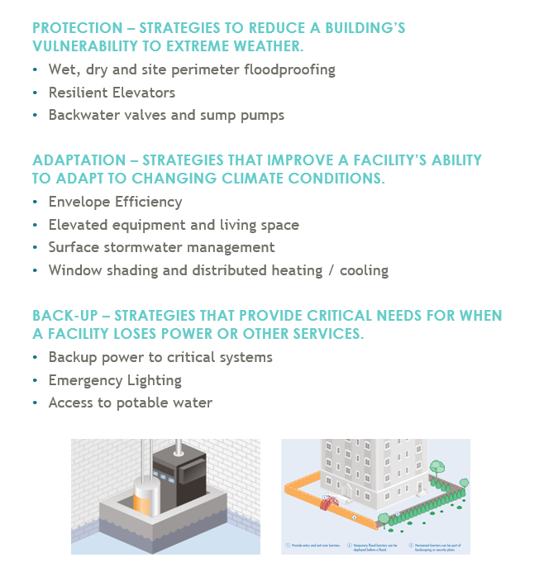
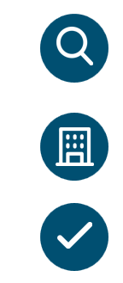
ASTM E3429 Standard Guide for
Property Resilience Assessments
Stage 1
Stage 2
Stage 3
Hazard Screening & Identification
Vulnerability & Risk Evaluation
Resilience Measures
Inspect
Hazard
X
Exposure
X
Vulnerability
Evaluate
RISK =
Assess
Source: Enterprise Communities

Slide 19

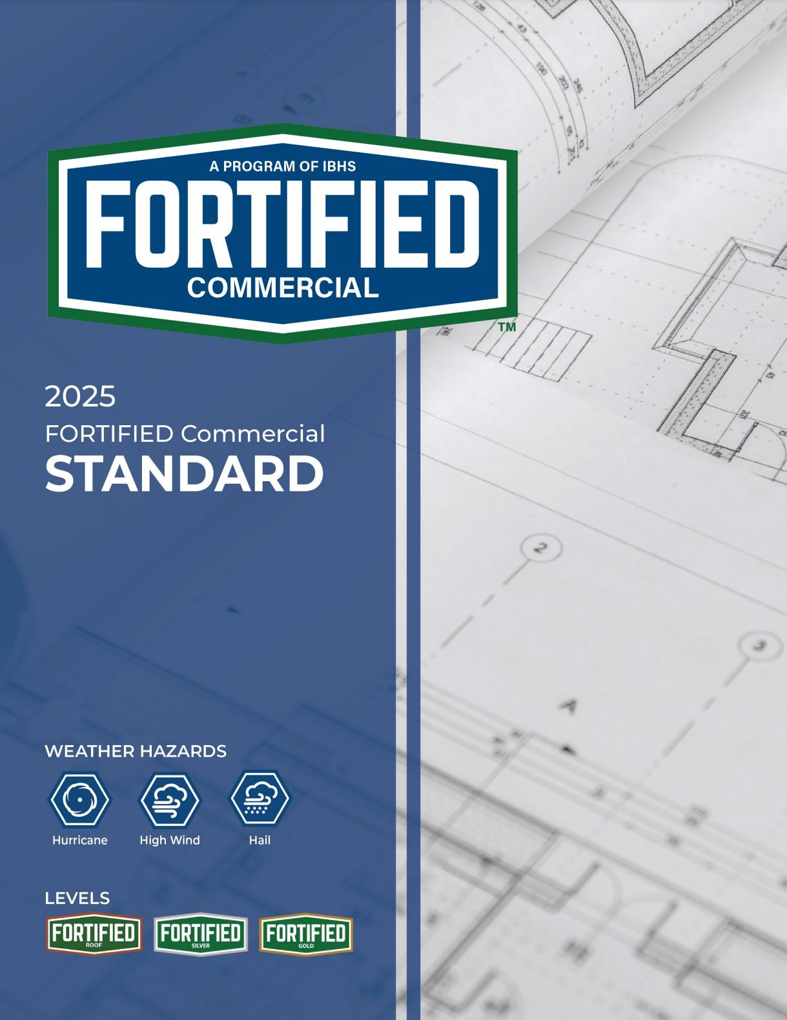




FORTIFIED Program by IBHS
What is FORTIFIED?
FORTIFIED is a voluntary construction and re-roofing Program designed to strengthen homes and commercial buildings against specific types of severe weather such as high winds, hail, hurricanes and even tornadoes.
FORTIFIED Standards include stricter requirements than code

Slide 20
Thank you!

